Slide 1
Chapter 1: Foundations for the Sonography Student

Slide 2
Chapter Objectives
Briefly explore vital concepts related to student success in sonography, including the anticipation of stress and goal setting.
Offer insight into classroom and clinical survival skills for sonography students.
Understand workflow in the hospital setting.
Appreciate the different imaging modalities that a sonography student will encounter while in the hospital or office setting.
Recognize how vital critical thinking skills are in the sonography profession.

Slide 3
Introduction
The sonographer is a critical part of the healthcare team.
Where does the student fit in?
Students can perform at varying levels of competency, from observing to conducting examinations.
This chapter will prepare you for your place in the sonography department by covering the following:
Managing stress
Financial considerations
Maintaining emotional and physical health
Time management and goals
Classroom and clinical survival skills
The role of the sonographer
Workflow and layout of an imaging department

Slide 4
Going Back to School
Prior to endeavoring to comprehend the life-altering obstacles that sonography school entails, we must first recognize the blended group of students that you will refer to as classmates.
In preparation for a patient care environment where compassion should persist, offer support to those you recognize as struggling in their studies, and work together to help each other succeed.
If you truly desire to be successful in healthcare, then having the ability to work well with others is critical.
It will ultimately benefit you to keep in mind that the people whom you share the classroom with now perhaps one day could be a coworker or even your supervisor.

Slide 5

Stress: Inevitable but Manageable
Stress is inevitable; it is a normal reaction to challenging situations.

Slide 6
Stress: Inevitable but Manageable (cont.)
Stressors are events or other challenges to time, energy, or resources.
Stressors cause anxiety, a state of worry or fear.
In the fight-or-flight response, hormones cause increased heart rate, shallow and rapid breathing, sweaty palms, and an energy surge.
Stress can be an immediate response or can build up over time.
Anxiety has cognitive, physical, and behavioral components.
Learn to recognize causes of stress and anxiety to be prepared and practice self-care through intervention techniques.

Slide 7
Stress: Inevitable but Manageable (cont.)
Destructive behavior resulting from anxiety includes removing yourself from a situation to avoid potential negative outcomes, dealing with stress with excessive alcohol use or reckless behavior, or procrastinating.
Some individuals may overcompensate to avoid anxiety and ultimately overprepare for tests, resulting in poor score.
Constructive behavior to combat stress should initially involve recognizing that we are indeed stressed by identifying the stressor, analyzing the reason behind the feelings of stress (e.g., loss of control, unpreparedness, etc.), and trying to intercede by performing stress-reducing activities.

Slide 8
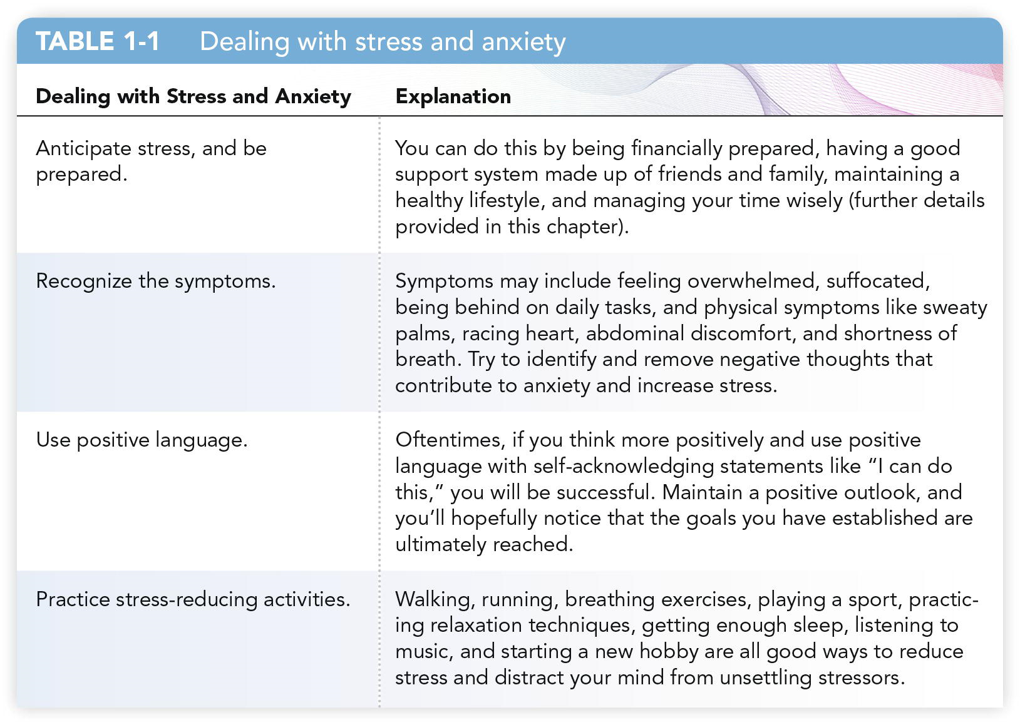
Dealing with Stress and Anxiety

Slide 9
Stress: Inevitable but Manageable (cont.)
While many of us see stress as a hindrance, stress can actually be used as a motivator for some people.
Studying harder for a difficult exam so that you are prepared is a means to compensate for and combat against anxiety.
Feeling prepared and rising to the occasion makes you feel successful and boosts self-esteem.
While envisioning worst-case scenarios can lead to increased stress and anxiety, spending time focusing on positive thoughts and success will help ease your mental weariness.

Slide 10
Financial Preparedness
Annual salaries vary per specialty.
In 2018, the Society of Diagnostic Medical Sonography (SDMS) reported that the median base hourly wage for a sonographer was $35.16.
The career is in demand!
You must be financially prepared for your education.
Develop a budget.
Consider working during school.
Do not overextend yourself; physical exhaustion can lead to a lack of focus.
Consider seeking financial assistance.
Employers may offer support.
State and federal programs offer low-interest loans, gifts, grants, and scholarships.
Consult your tax advisor about incentives for students.

Slide 11
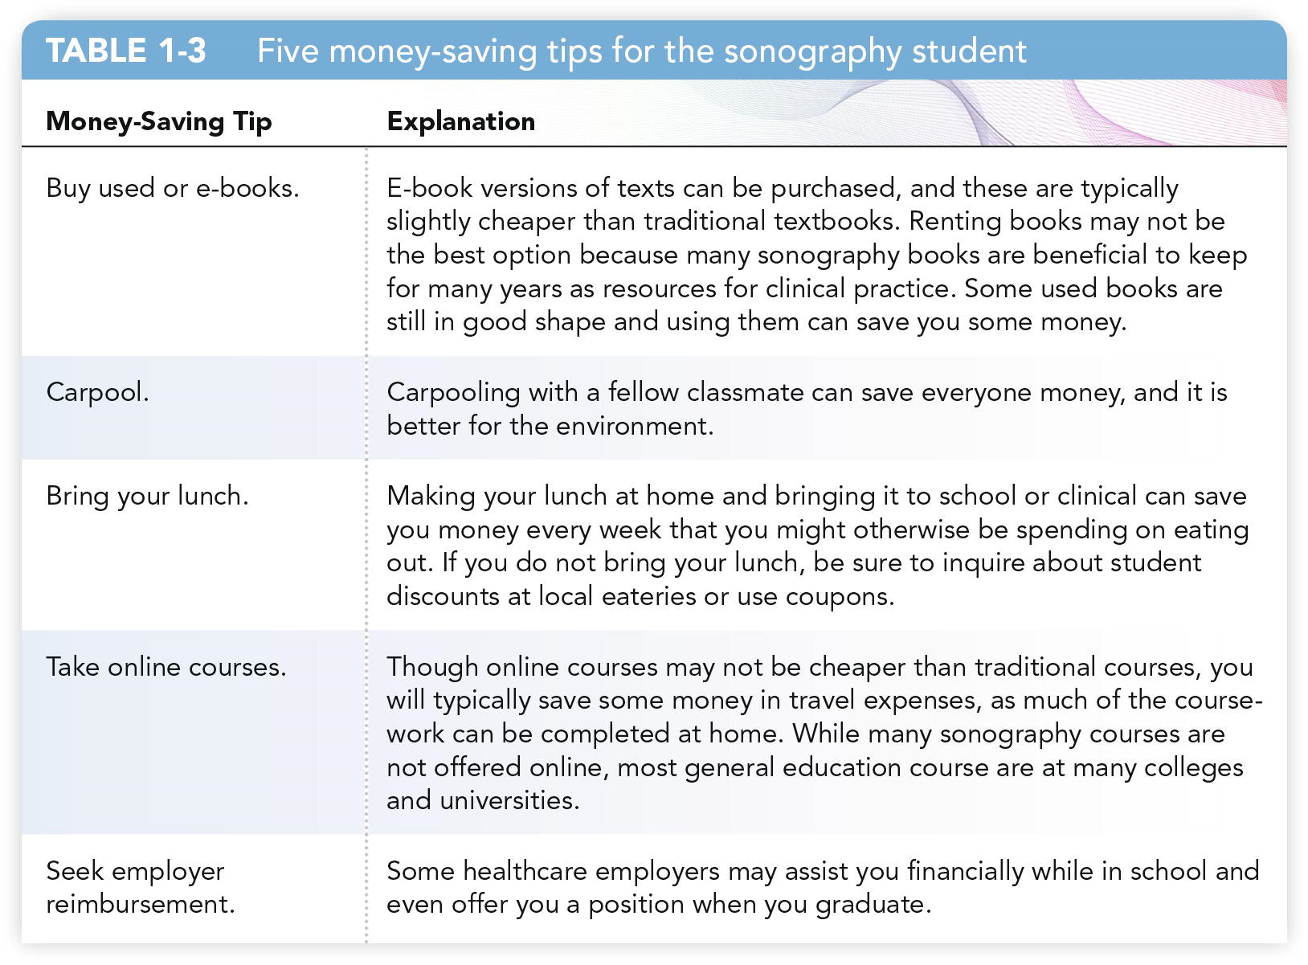
Money Saving Tips

Slide 12
Financial Preparedness (cont.)
Federal student aid applications are available online at www.fafsa.ed.gov.
Also, secondary forms of savings that some may be eligible to receive include tax credits for both tuition and fees.
It would be wise to consult your tax advisor while in school to determine what tax incentives exist for full-time students, as these may vary from year to year.
Seek help when needed, and take advantage of student support services, your academic advisors, and student counseling when you encounter financial strain.

Slide 13
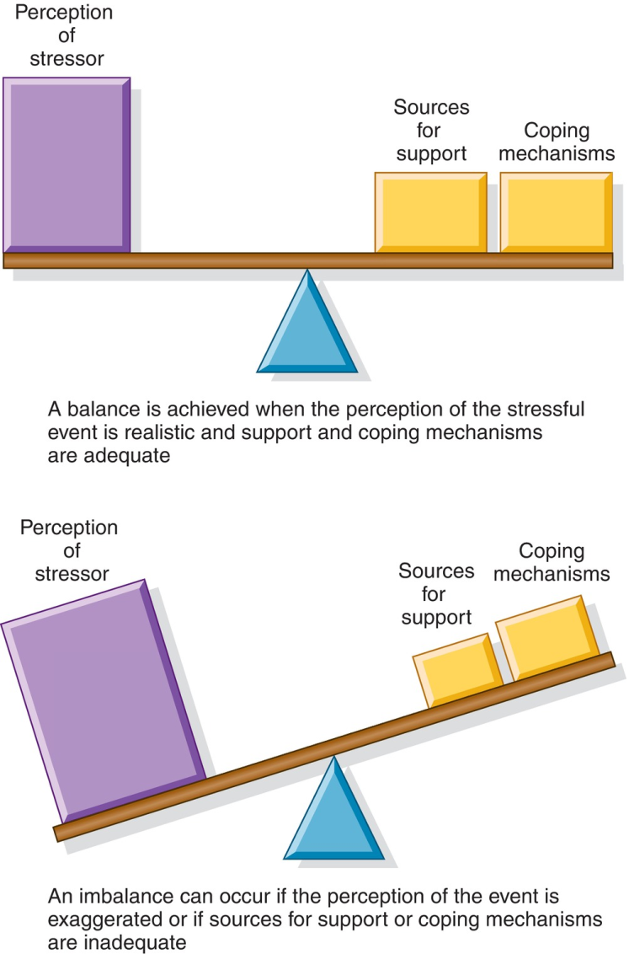
Emotional Stability and Support
A person who is mentally healthy is able to maintain a state of emotional balance on most days.
Stress can drag us down, causing the scale to tip out of balance, but a person who is mentally healthy is able to adjust to the stress and return to a state of emotional balance.

Slide 14
Emotional Stability and Support (cont.)
Tell your loved ones about the demands on your time.
Seek engagement with friends and family during stressful times.
Consider involving your family and friends in your studies.
Tell them about assignments.
Seek their help in studying for tests and practicing patient positioning and procedures.
Seek engagement with other students, sonographers, and faculty members.
Your program may offer student mentoring.

Slide 15
Physical Well-Being
Before beginning sonography programs, students often must undergo a physical examination including:
Immunization
Laboratory tests
Drug screening
A positive result can lead to dismissal from your program or job.
Tips for maintaining your physical well-being include:
Regular exercise
A well-balanced diet
Adequate sleep
Taking breaks from studying to engage in physical activity

Slide 16
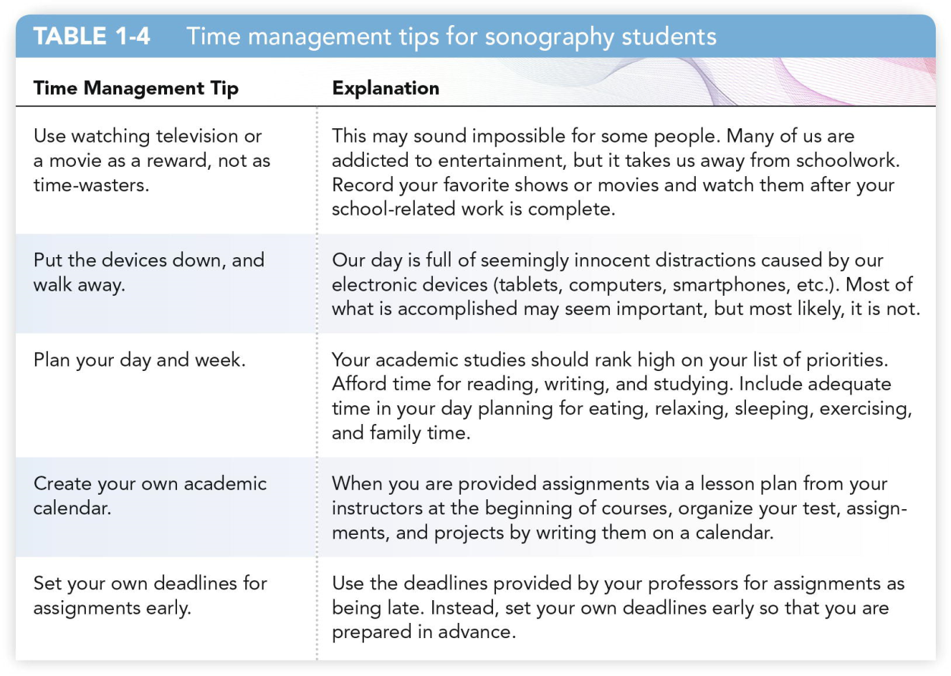
Time Management
Time management is crucial, but finding a balance in your life may be challenging. Work to develop your time management skills.

Slide 17
Establishing Personal Goals
Personal goals can be described as subjectively meaningful aspirations that individuals pursue as they go through life.
Goals can be described as short-term, medium-term, or long-term.
Short-term goals as urgent, medium-term goals are reachable in 1 to 5 years, and long-term goals are achievable in more than 5 years.
Most people arrange their goals using a hierarchical organization; thus, placing the most urgent goals first and long-term goals last is a traditional way to consolidate goals.

Slide 18
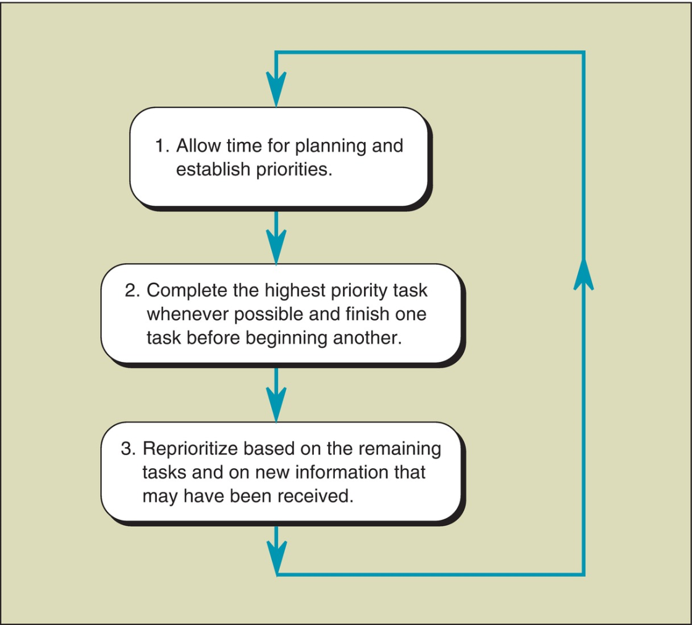
Time Management (cont.)
Three fundamental steps in time management

Slide 19
Establishing Educational Goals
An educational goal may be to simply pass a test or to obtain your degree. Of course, educational and personal goals often overlap.
An example of a long-term educational goal for you is hopefully to become a certified sonographer in your chosen specialty area, or perhaps even becoming a multicredentialed sonographer.
Short-term goals and medium-term goals can exist solitarily or can be combined and realized as a means of obtaining a long-term goal.
An example of a goal in the classroom is that of preparing and doing well on tests (short-term goals) in the hopes of achieving an excellent grade for the course (long-term goal).

Slide 20
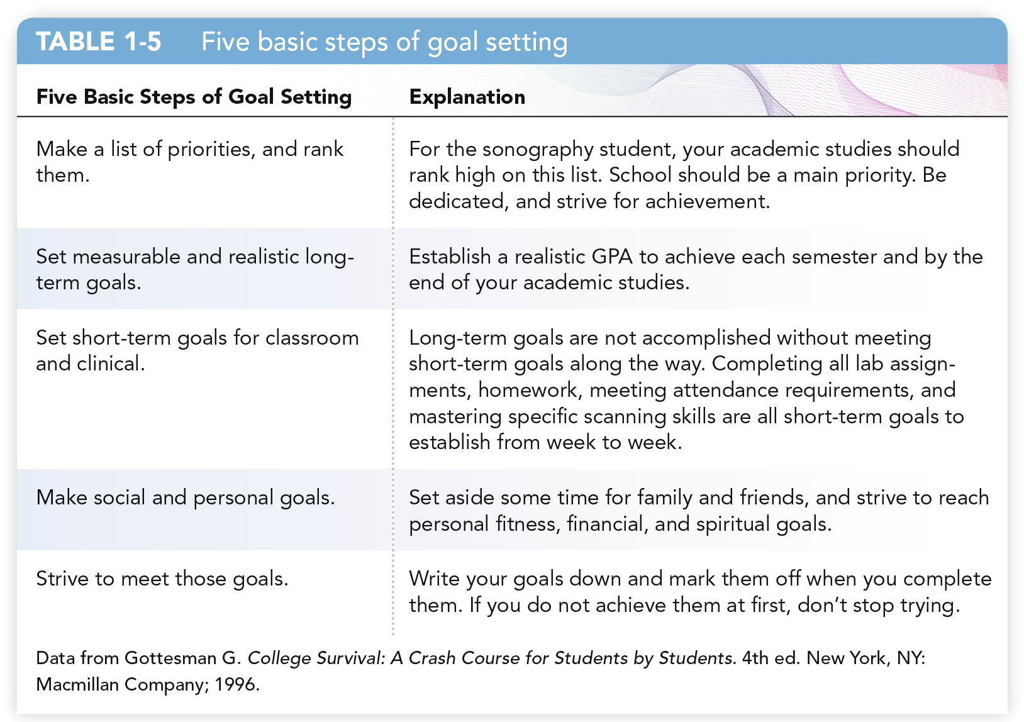
Establishing Educational Goals (cont.)

Slide 21
Classroom Survival Skills
Successful students have numerous skills in common, including:
Sitting near the front of the classroom
Having healthy snacks before lectures
Taking good notes
Asking questions to seek clarity
Efficiently preparing for tests
It is easy to become overwhelmed when encountering a large amount of complicated information. Develop classroom survival skills in the following areas:
Pertinent coursework
Preparing for tests
Maintaining motivation in the classroom

Slide 22
Classroom Survival Skills (cont.)
Learning styles are various approaches that individuals use toward learning, and thus understanding your preferred learning style can be a basic and yet useful preliminary educational step that you can perform in order to be better prepared for the educational trials of sonography school.
Learners are often categorized as tactile learners, auditory learners, or visual learners.
Tactile learners, which may be referred to as kinesthetic learners, prefer learning by touching or doing, while auditory learners prefer listening or hearing, and visual learners prefer reading or seeing pictures

Slide 23
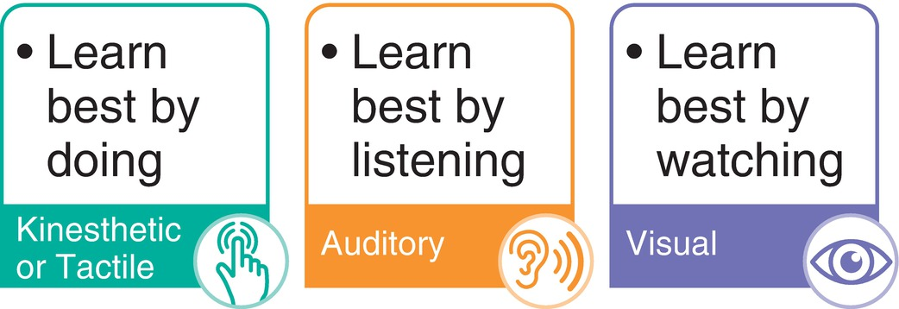
Classroom Survival Skills (cont.)
By finding out what type of learning style you prefer (see link below), you may be able to hone your study skills and improve your ability to retain information
http:// www.educationplanner.org/students/self-assessments/learning-styles-styles. shtml.

Slide 24
Preparing for Tests
Read your textbooks for comprehension.
Take quality lecture notes.
Create study cards and mnemonics.
Form a study group or find a study partner.
Develop a study schedule and take breaks.

Slide 25
Preparing for Tests (cont.)
Find your own personal preparation style.
Aim to learn the information rather than simply memorizing it.
Genuine understanding of concepts directly impacts clinical practice and patient care.
Seeking support for test anxiety can significantly increase your scores.
Brain dumping should be a last resort.
It is prohibited on national certification exams.
Your goal should be to retain and comprehend course content.
Continually review information throughout your program.

Slide 26
Test-Taking Tips
Examine the length of the test.
Estimate the time for different parts.
Answer one item at a time.
Look for keywords in the questions.
Eliminate obviously erroneous answers.
Return to harder questions.
Hesitate before changing an answer.
Make a quick outline of your thoughts before answering essay questions.

Slide 27
Learning-Testing Cycle
The learning-testing cycle is a method that we all subconsciously utilize as we progress through an educational program.
This cycle includes a preparation phase, performance phase, and reflection phase.
The preparation phase includes studying, of course, and also a study routine that has been established over time that may or may not be helpful.
The performance phase is the actual testing attempt.
The reflection phase is the phase of assessment, not only by obtaining a numeric grade but also an evaluation of one’s overall strategic performance on the examination.

Slide 28
Maintaining Motivation in the Classroom
It is easy to become overloaded with the amount of work in a sonography program.
Approach one exam at a time.
Looking too far ahead can cause anxiety.
Put full effort into focused, dedicated study time for each exam as it comes up.
Reward your efforts when you do well on a test or examination.
Avoid feeling depressed over test scores.
Strive to do better on the next one.
Make notes of where you struggled.
Ask your instructors for guidance.
Use school breaks to relax your mind with enjoyable activities.

Slide 29
Clinical Survival Skills
Your success in the clinical setting depends on the following:
The role of the sonographer
Utilizing the scan lab
Maintaining professionalism
Maintaining your work ethic
Observe how sonographers interact with patients, the interpreting physician, and others on the healthcare team.

Slide 30
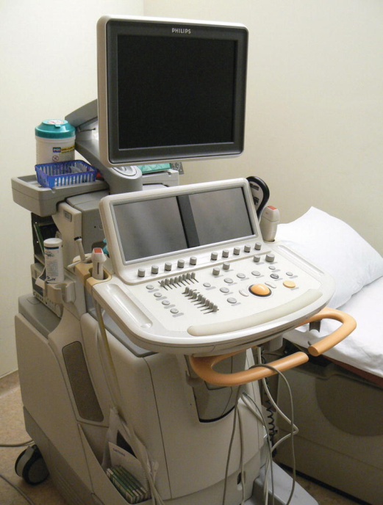
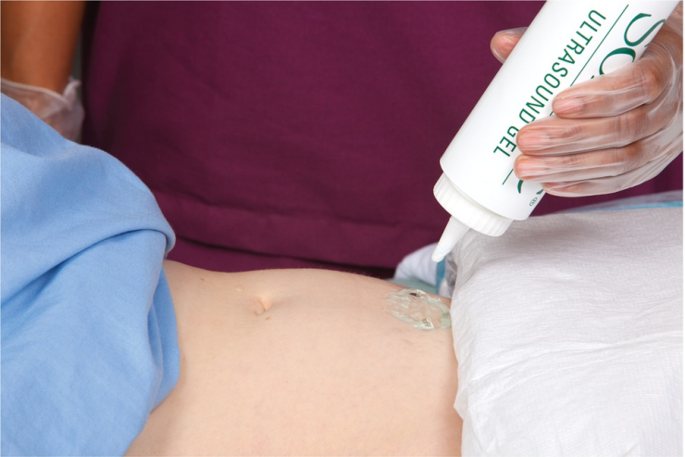
The Sonographer: A Brief Overview
A sonographer is a highly skilled medical professional who uses special equipment that emits ultrasound to create diagnostic images of the human body.
A physician or other qualified professional interprets the created images.

Slide 31
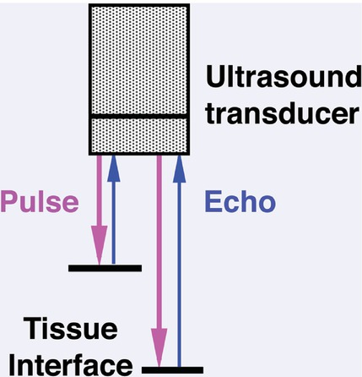
The Sonographer: A Brief Overview (cont.)
Pulse-echo technique:
The transmitted pulse encounters tissue interfaces, or boundaries, that reflect a portion of the sound beam back to the transducer.
The depth of the tissue interface is determined by the round-trip time of flight for the transmitted pulse and the returning echo.
The echo is then demonstrated on the monitor as a single dot.

Slide 32

The Sonographer: A Brief Overview (cont.)
Before an examination, the sonographer obtains a clinical history.
After the examination, the sonographer prepares a sonographer report. This gives:
Basic descriptive information of the study
Manifestation of any sonographically identifiable abnormalities.
Sonographers should not be diagnosticians.
If sonographers provide diagnostic information to patients, they may be held legally liable.

Slide 33
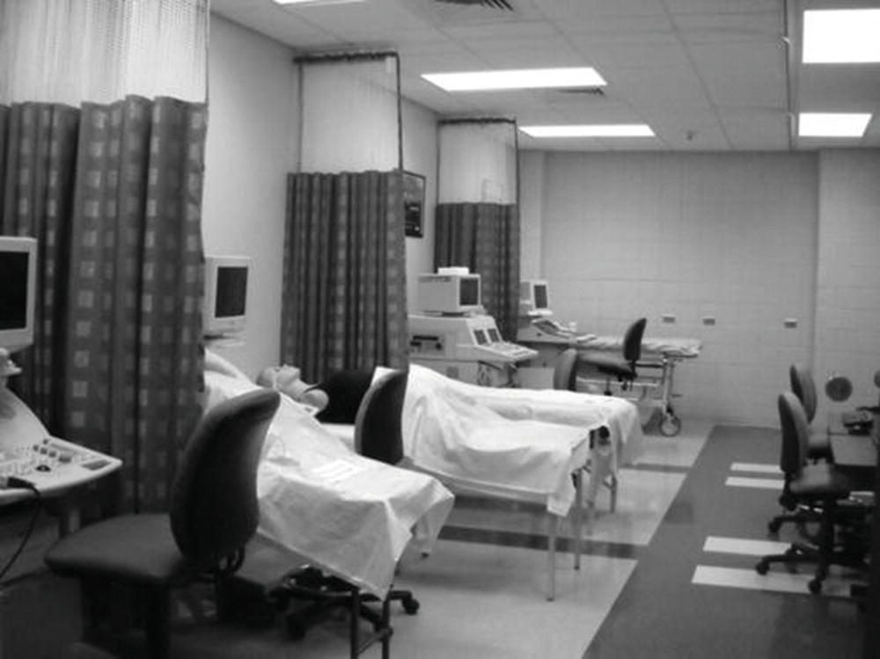
Utilizing the Scan Lab
Utilize the lab as much as possible: Practice will help you gain confidence and skills!
Your program most likely contains clinical competencies that ask you to perform sonographic examinations unassisted.
Some programs provide sonography phantoms (see image) for practice.
Students who practice scanning after the sonographer in a clinical setting are more capable of finding organs and acoustic windows.

Slide 34
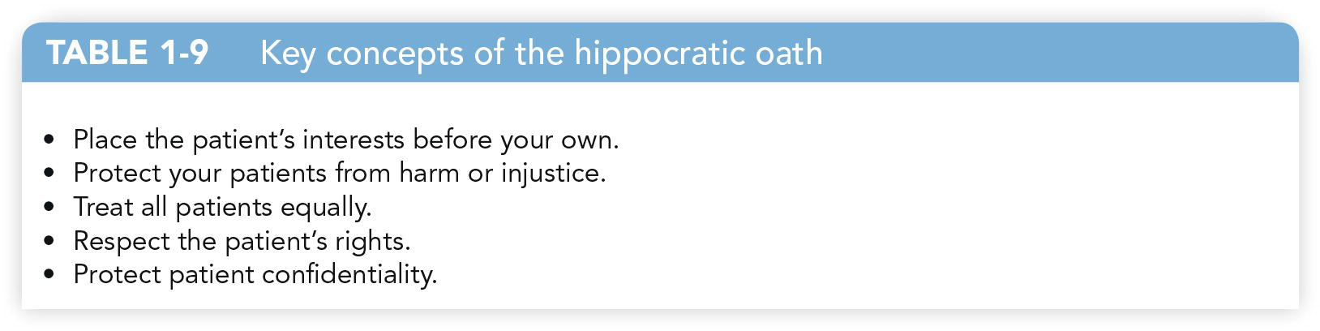
Professionalism in the Clinical Setting
How you perform in clinical settings is just as or more important than how you perform in the classroom.
You are ultimately defined by your clinical competence and skillful patient care.
Medical ethics go hand-in-hand with professionalism.
You must recognize the importance of the Hippocratic Oath.

Slide 35
Professionalism in the Clinical Setting (cont.)
HIPAA (1996) included provisions requiring safeguarding patient information.
This means there are strict rules for maintaining patient confidentiality.
Do not share diagnostic information with people not directly involved in the patient’s care.
Never speak about a patient’s exam or medical information anywhere you can be overheard by bystanders.
Strive to maintain patient privacy.
Keep your patients covered, especially when the examination is not in process.

Slide 36
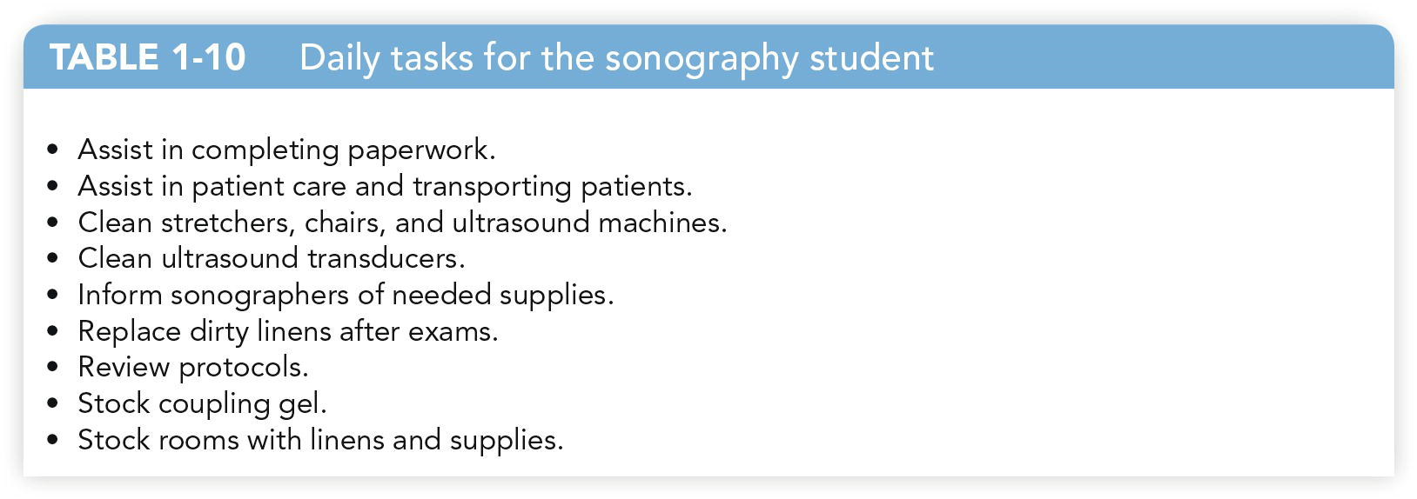
Work Ethic in the Clinical Setting
Maintain professional conduct.
Every clinical rotation is a job interview.
Assist sonographers with their daily responsibilities.

Slide 37
Work Ethic in the Clinical Setting (cont.)
Be someone on whom the team can always rely.
Be accountable: Uphold your obligations and admit when you have made a mistake.
Sonographers are responsible for patients’ lives—mistakes must be remedied as quickly as possible.
Honesty is ALWAYS the best policy.
Patient service should guide your actions.
Maintain a positive attitude.

Slide 38
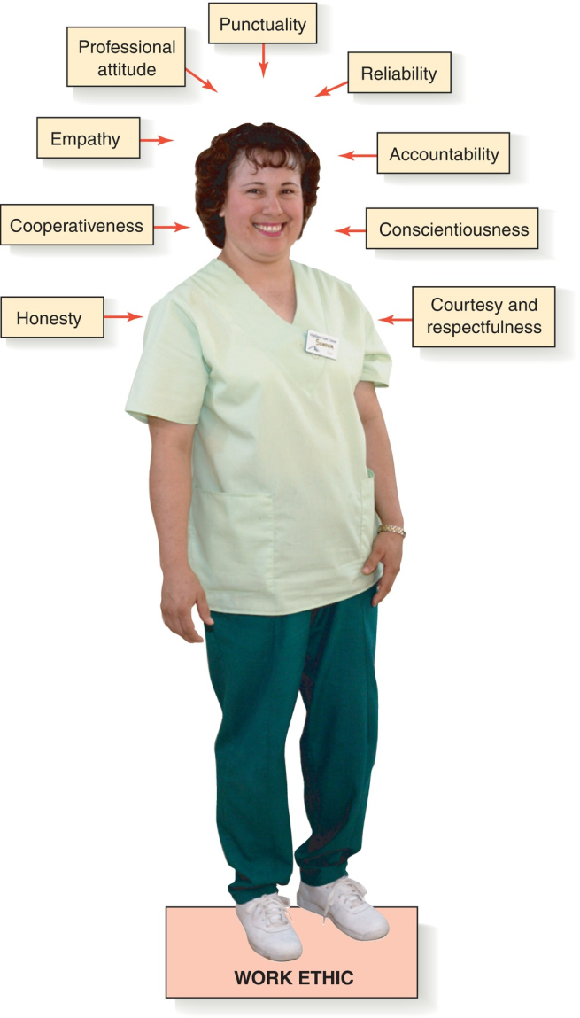
Work Ethic in the Clinical Setting (cont.)

Slide 39
Work Ethic in the Clinical Setting (cont.)
Your attitude and amount of enthusiasm that you bring to clinical are constantly examined.
If you consistently have a negative attitude about learning your chosen profession, you may possibly want to review the reasons why you chose this profession to pursue.
For example, if you are constantly on your cell phone or viewing your smartwatch, then the sonographer or clinical instructor working with you will most interpret this action as laziness or disinterest.
The best choice would be to leave such devices out of the patient care setting.

Slide 40
Clinical Orientation and Information Gathering
You may be required to visit numerous healthcare facilities.
It is your responsibility to learn the unique policies and procedures of each institution before interacting with patients.
Clinical orientation tasks include:
Obtaining a map of the department
Locating emergency crash carts
Making copies of sonographic protocols
Familiarizing yourself with ultrasound machines
Locating supplies
Locating material safety data sheets and manuals
Obtaining a list of emergency codes

Slide 41
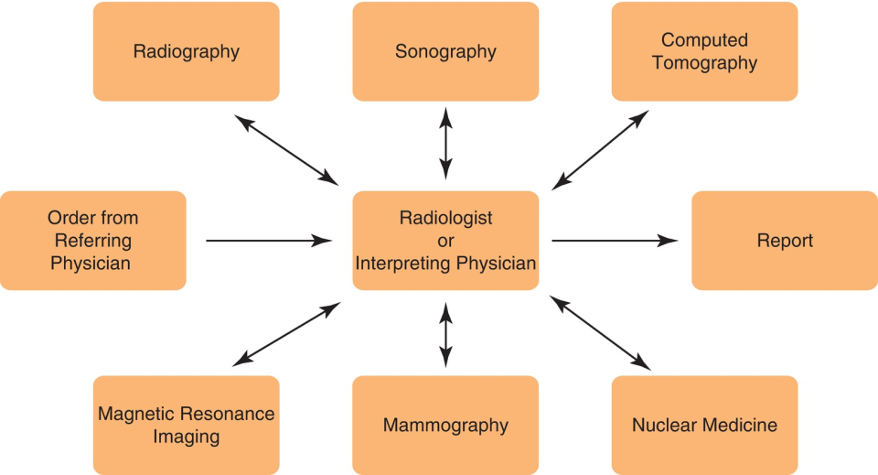
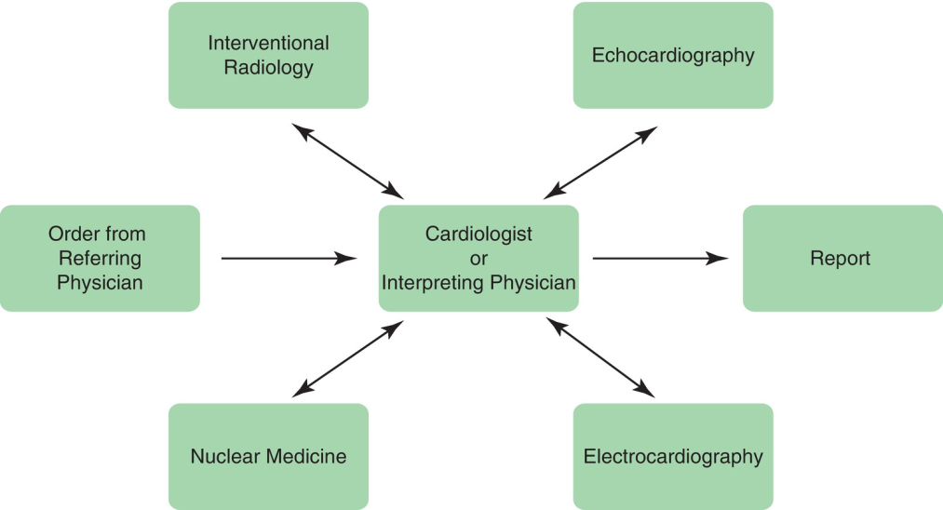
Understanding Workflow and the Imaging Department
Learn where you fit in by viewing the entire process of how a patient moves through the organization.
Licensed physicians or other authorized professional provide an order for sonographic examination.
Imaging departments vary, but most center on the interpreting physician.

Slide 42
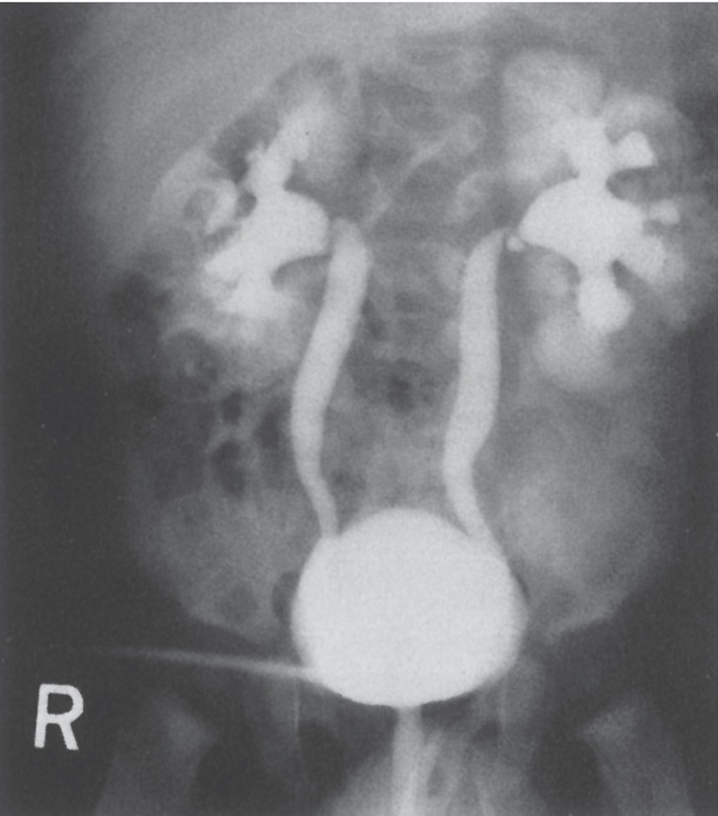
Radiography (X-Ray)
This is the oldest of the diagnostic modalities in the imaging department.
Radiographers are trained medical professionals who utilize x-ray or ionizing radiation to obtain images of the body.
Radiographers may also assist during fluoroscopy, pyelography, and orthography.
Most departments now use digital radiography to store and view images on a computer.

Slide 43
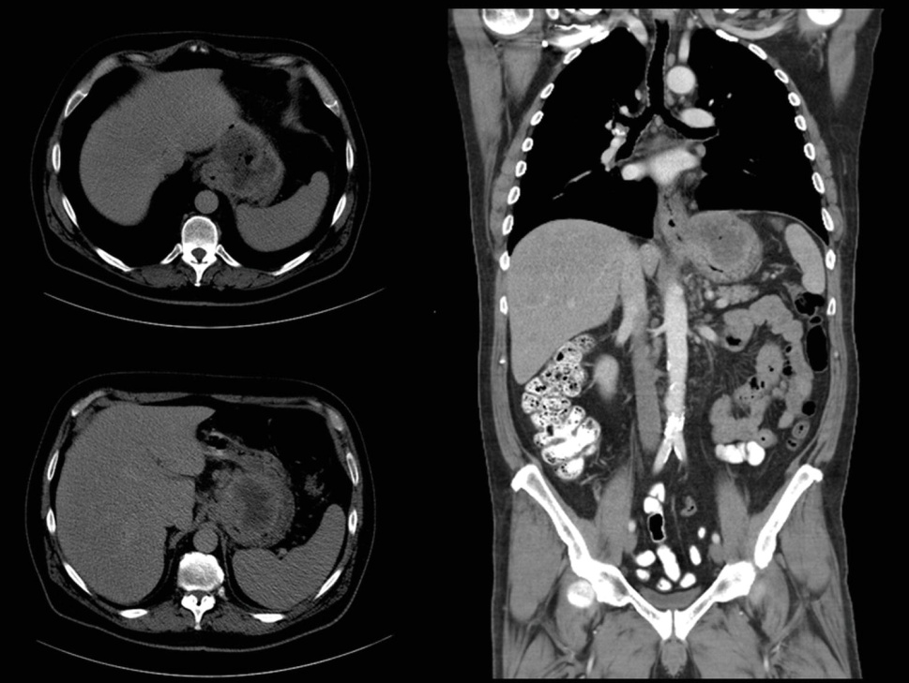
Computed Tomography (CT or CAT scan)
This modality also uses x-ray to obtain images.
CT provides high-resolution sectional viewing of the body in multiple planes.
It is often used in trauma, during invasive procedures, and routine outpatient procedures.
You should work to establish an understanding of CT, as your procedures may be correlated with CT studies.

Slide 44
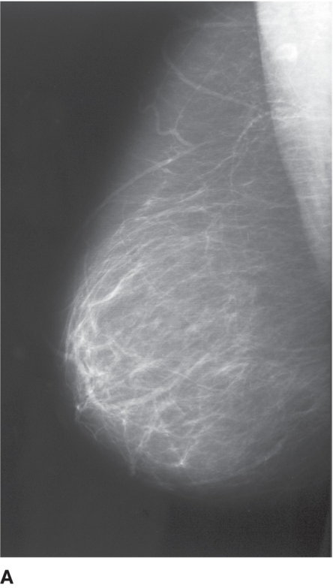
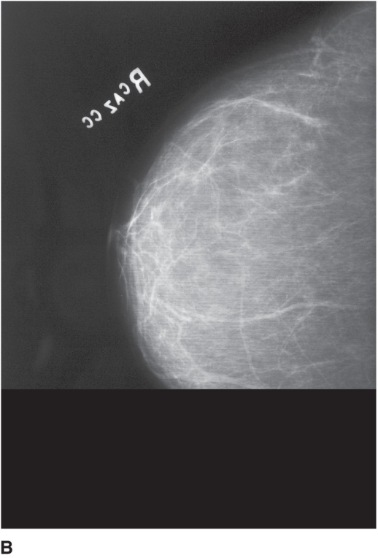
Mammography
Mammographers use x-rays to obtain an image of the breast.
It is recommended that all women 40+ have an annual screening mammogram.
You should familiarize yourself with mammographic views of the breast in order to understand the location of breast pathology and appearance of disease.

Slide 45
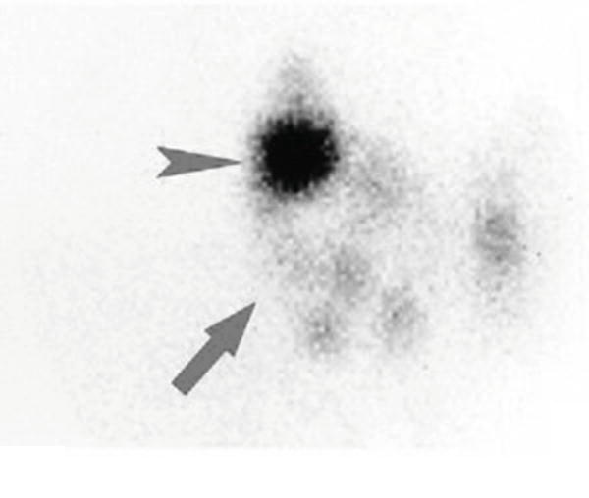
Nuclear Medicine Technology
Nuclear medicine utilizes radioactive material for the diagnosis and treatment of various diseases or to differentiate normal and abnormal structures in the body.
Patients inhale, ingest, or are injected with a radiopharmaceutical.
These are capable of concentrating on a specific organ or system.
Nuclear medicine technologists operate a gamma camera to detect the emitted radiation, thus creating an image.

Slide 46
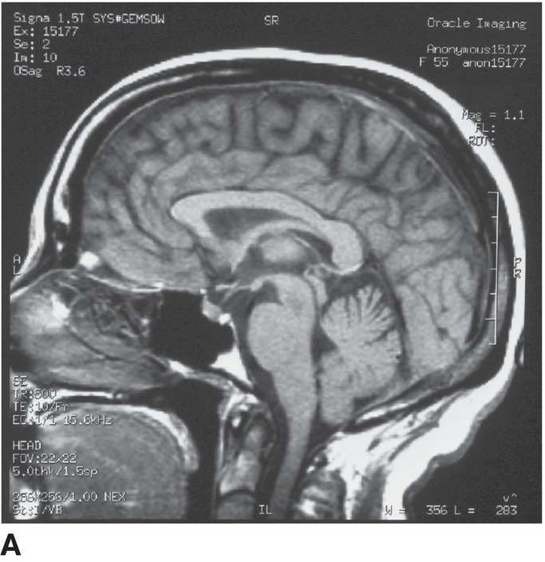
Magnetic Resonance Imaging
This uses a powerful magnetic field, radio waves, and a devote computer system to create sectional images of the human body.
MRI provides excellent resolution of internal structures and is used to evaluate disease all over the body.
Patients may be injected with a contrast agent.

Slide 47
Cardiovascular Interventional Technology
Heart catheterization is performed with the assistance of a cardiovascular interventional technologist.
X-ray dye is used to image the vessels of the heart for signs of occlusion.
Vascular interventional radiographers assist radiologists in stent placement for organs like the liver.

Slide 48
Appreciating Critical Thinking
Acquiring and utilizing critical thinking skills are significant components of performing adequate patient care.
These skills include resourceful actions, judgments, and decisions based on the combination of professional knowledge, experience, integrity, and ethical standards.
Basically, you use the best thinking of which you are capable in any set of circumstances.
In sonography, this involves applying a code of ethics to the decision-making process.
You must be able to correlate clinical history with sonographic findings to guide the examination.
Obtaining reliable information is the most significant component of critical thinking and decision-making.
Be aware of the difference between making inferences and making assumptions.

Slide 49
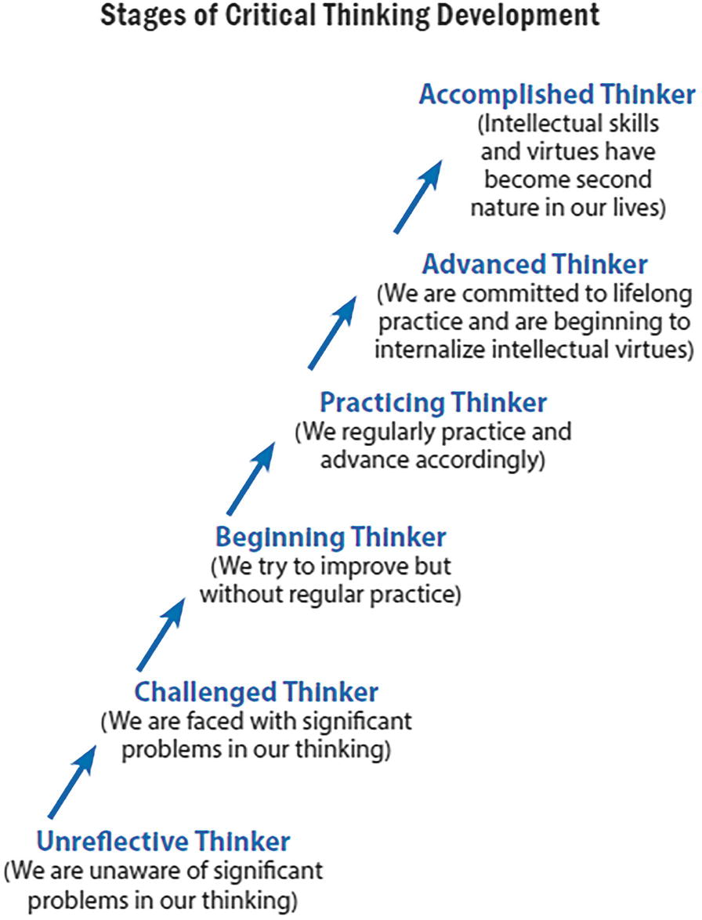
Appreciating Critical Thinking (cont.)

Slide 50
Appreciating Critical Thinking (cont.)
Qualities of Well-Cultivated Critical Thinkers:
Asks vital questions and recognizes problems
Gathers and assesses relevant information
Comes to well-reasoned conclusions and solutions
Tests conclusions and solutions against relevant criteria
Thinks with an open mind
Communicates effectively with others in order to figure out solutions to complex problems

Slide 51
Appreciating Critical Thinking (cont.)
Critical thinkers have the ability to raise discriminating questions in an attempt to identify better ideas, establish a deeper question, or to find solutions to issues.
For example, a sonographer applying critical thinking skills will consistently delve deeper into patient history to discover the most essential facts and establish inferences or conclusions based only on those facts.

Slide 52
Student Application of Critical Thinking
There is a clear, positive correlation between the amount of clinical experience one has and diagnostic accuracy.
The more experience you gain, the higher the probability that your interpretations will be correct.
Your educational experience will help you gain critical thinking skills.
Observe seasoned sonographers and evaluate the way they interact with patients, other healthcare workers, and interpreting physicians.
Keep a clinical journal to keep notes on institutional information and professional reflection.
Keeping such a journal can also be therapeutic.

Slide 53
Summary
Going back to school can be complicated, especially when it’s sonography school. Stress is inevitable.
Sonographers are created in clinical! Clinical is where you apply your gained classroom and laboratory knowledge.
Sonography school is demanding but rewarding. It is stressful but manageable.
Make the decision now to develop classroom and clinical skills that are geared toward providing all patients with adequate care.

